Slide 1

Machine Learning Using Python
-

Slide 2
Decision Trees
Decision tree learning is one of the most widely adopted algorithms for classification.
As the name indicates, it builds a model in the form of a tree structure.

Slide 3
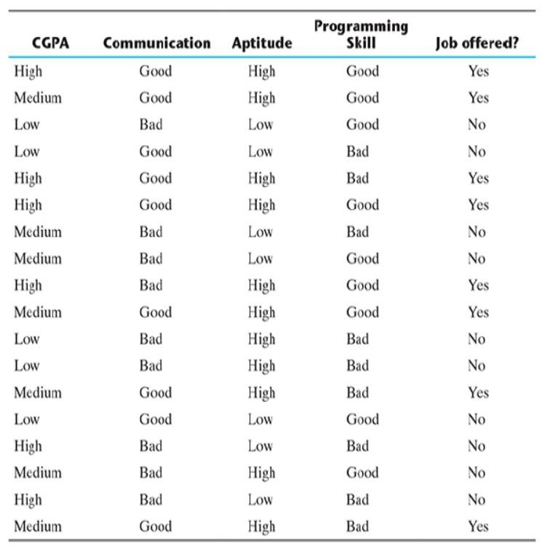
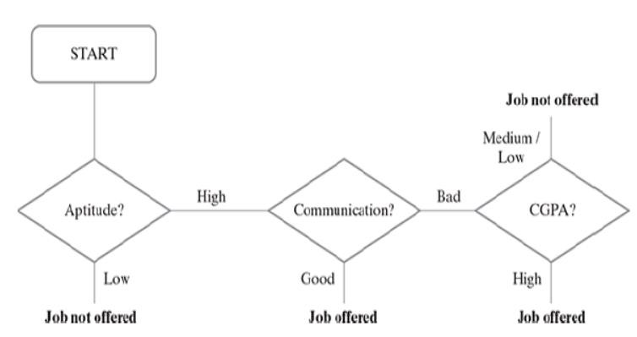

Slide 4
Decision Tree Implementation
There are many implementations of decision tree, the most prominent ones being C5.0, CART (Classification and Regression Tree), CHAID (Chi-square Automatic Interaction Detector) and ID3 (Iterative Dichotomiser 3) algorithms.
The biggest challenge of a decision tree algorithm is to find out which feature to
split upon.
The main driver for identifying the feature is that the data should be split in such a way that the partitions created by the split should contain examples belonging to a single class. If that happens, the partitions are considered to be pure.

Slide 5

Entropy
Entropy is a measure of impurity of an attribute or feature adopted by many algorithms such as ID3 and C5.0.
Let us say S is the sample set of training examples. Then, Entropy (S) measuring the
impurity of S is defined as
where c is the number of different class labels and p refers to the proportion of
values falling into the i-th class label.

Slide 6

Information Gain
The information gain is calculated on the basis of the decrease in entropy (S) after a data set is split according to a particular attribute (A).
Constructing a decision tree is all about finding an attribute that returns the
highest information gain (i.e. the most homogeneous branches).
Information gain for a particular feature A is calculated by the difference in entropy before a split (or S_{bs} ) with the entropy after the split (S_{as} ).

Slide 7
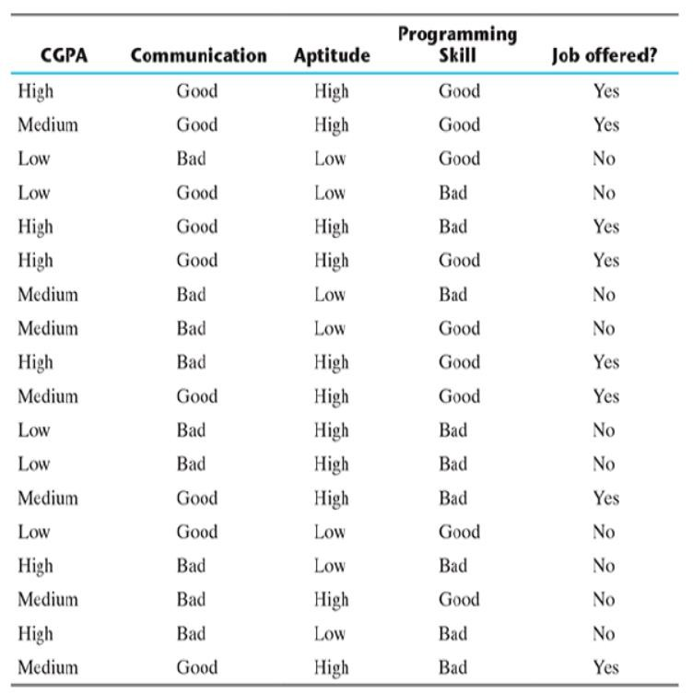

Slide 8
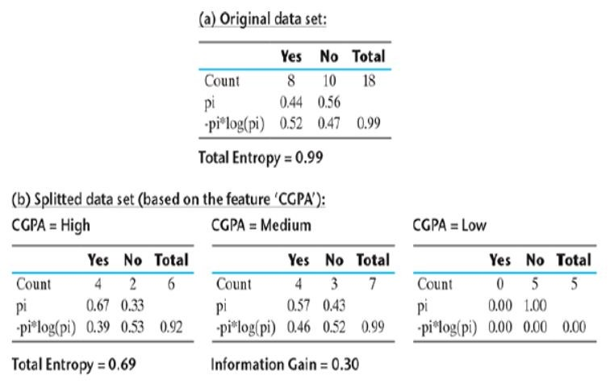

Slide 9
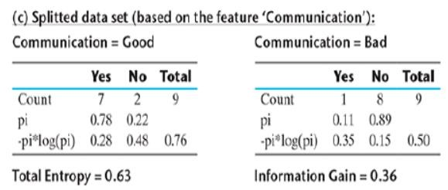

Slide 10
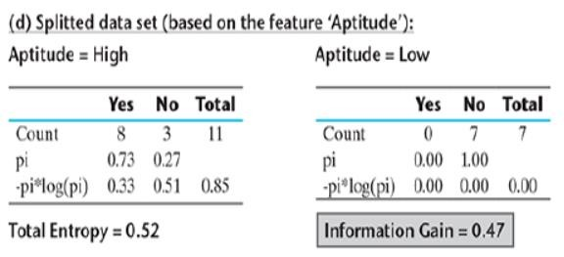

Slide 11
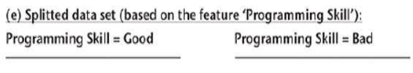
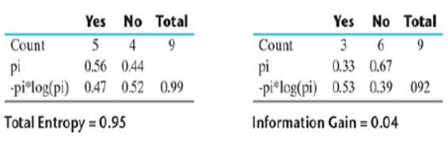

Slide 12
Aptitude
Hence, it is quite evident that among all the features, Aptitude results in the best information gain when adopted for the split.
So, at the first level, a split will be applied according to the value of Aptitude or in
other words, Aptitude will be the first node of the decision tree formed.
One important point to be noted here is that for Aptitude = Low, entropy is 0, which indicates that always the result will be the same irrespective of the values of the other features.
Hence, the branch towards Aptitude = Low will not continue any further.

Slide 13
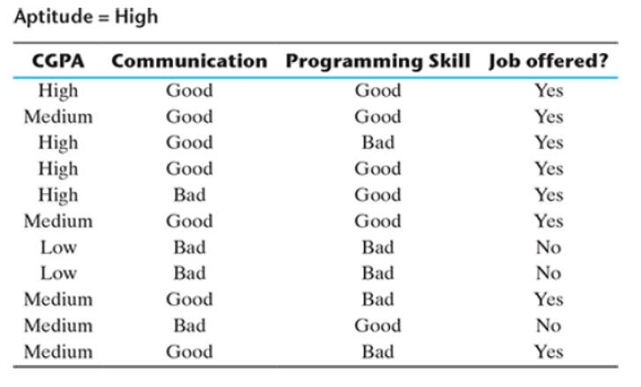

Slide 14
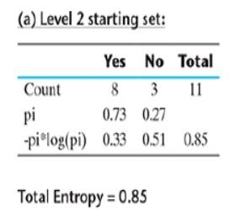

Slide 15

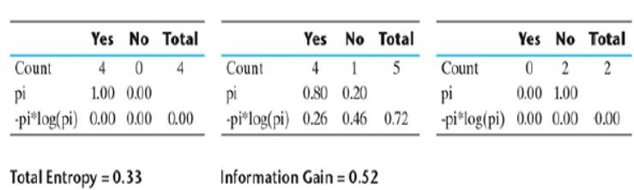

Slide 16
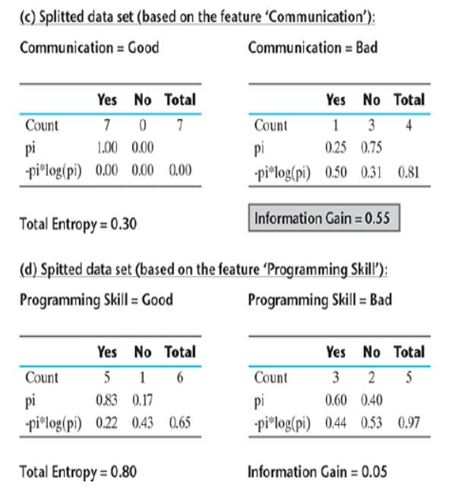

Slide 17

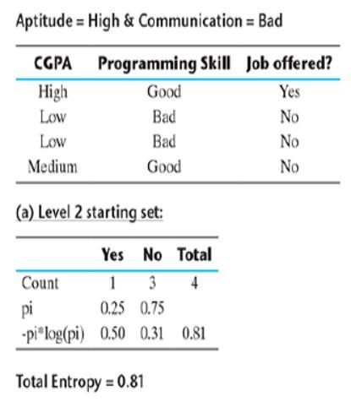
3
3

Slide 18
